Slide 1
GLOBE GLIDERS TOURS N TRAVELS

Slide 2
Team Details
2103A52055-M.Dheeraj
2103A52118-P.Aashish
2103A52128-CH.Rohith
2103A52136-G.Suraj
Under Guidance:
Padala Sravan Sir

Slide 3
Introduction
In today's fast-paced world, where travel and exploration have become integral aspects of our lives, the role of a well-crafted and user-friendly travel website cannot be overstated. Such platforms serve as digital gateways to a world of experiences, offering information, guidance, and inspiration to eager travelers. However, it's not uncommon to encounter travel websites that are cumbersome, unattractive, and cost-prohibitive, hindering both creators and users in their quest for meaningful journeys.

Slide 4
PROBLEM STATEMENT
The primary challenge our project aims to address is the need for a user-friendly and cost-effective website that can efficiently reach a wide audience. The current problem is that many existing websites in this domain lack user-friendliness, resulting in difficulties for people seeking travel information. Additionally, these platforms may not be budget-friendly for users or creators. Our project seeks to overcome these issues by developing a website that offers a superior user experience and is budget-friendly for both site owners and users, thereby providing a solution to the existing problem.

Slide 5
PROBLEM OBJECTIVE
The objective of this project is to develop a highly user-friendly, cost-effective travel website that provides an intuitive and accessible platform for individuals to plan and explore their travel interests. By creating a digital space that ensures a superior user experience and remains budget-friendly for both site owners and visitors, we aim to revolutionize the way people engage with travel information and experiences, making travel planning and exploration more accessible, enjoyable, and affordable for a wide audience.

Slide 6
SOLUTION
The solution to the identified problem entails the development of a streamlined, intuitive, and budget-conscious travel website that offers a user-centric design, comprehensive travel information, and cost-effective options for both users and website creators. This solution will leverage modern web design principles and cost-effective technologies to create an inclusive platform, ensuring that individuals can easily access, explore, and plan their travels, thus transforming the user experience in the travel industry.
We will be providing the tour packages they can be visited based on the budget and the number of days using GUI(Swings),if-else conditional statements ,switch case and exception handling concepts

Slide 7
ALGORITHAM
Budget
Output
(Tour Package)
1 day
input
No. of days
2 days
3 days
Output
(Total Amount)
No. of persons

Slide 8
INPUT
Input parameters are:
Budget
Number of Days
Number of Persons
Location

Slide 9
OUTPUT
Output that we obtain is:
Tour Packages
Total Amount
If budget input is out of mentioned in budget site , exception is raised and output’s the concerned statement.

Slide 10
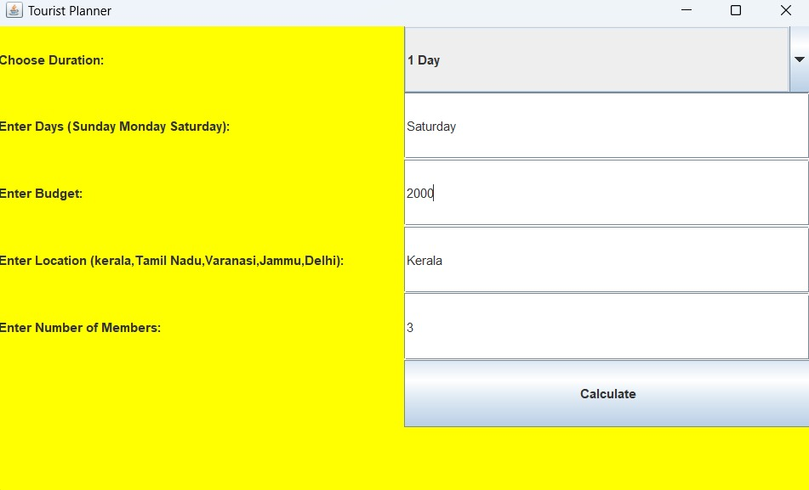
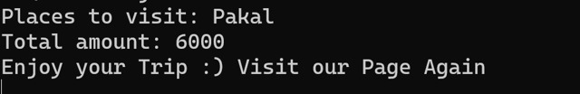
JUSTIFICATION

Slide 11
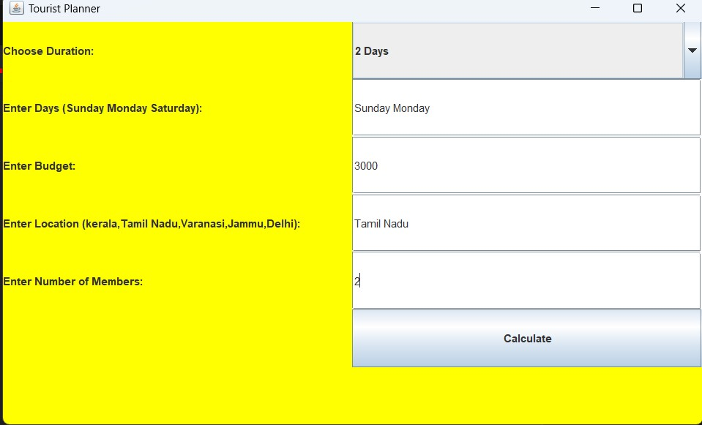
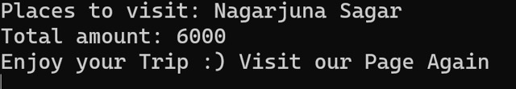

Slide 12
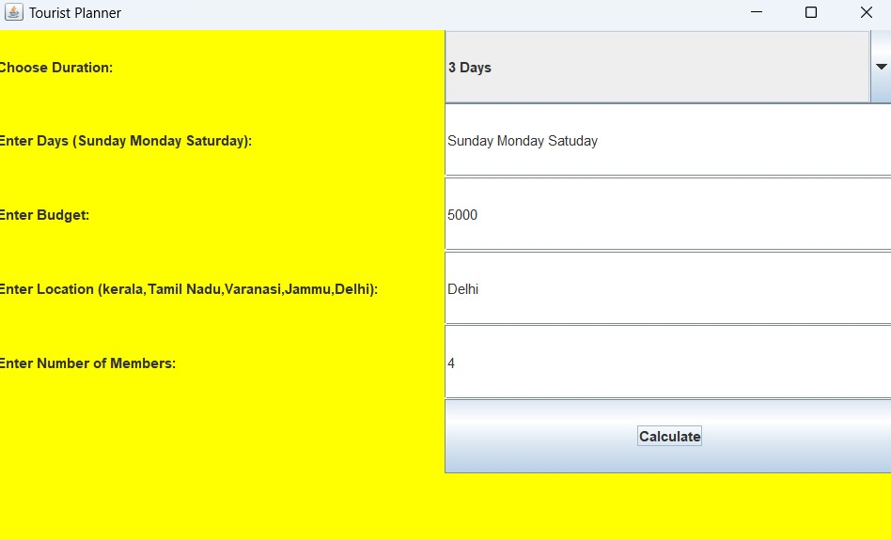
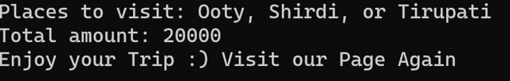

Slide 13
CONCEPTS
Exceptional Handling
GUI(Swings)
Scanner I/o
Strings
If-else Conditional Statements

Slide 14
THANK YOU

